Slide 1
MENTAL HEALTH:
THE CLERGY LOSS AND GRIEF
QUINTON ADAMS
PSYCHOLOGIST AND RESEARCHER
qadamsster@gmail.com
082 698 5103

Slide 2
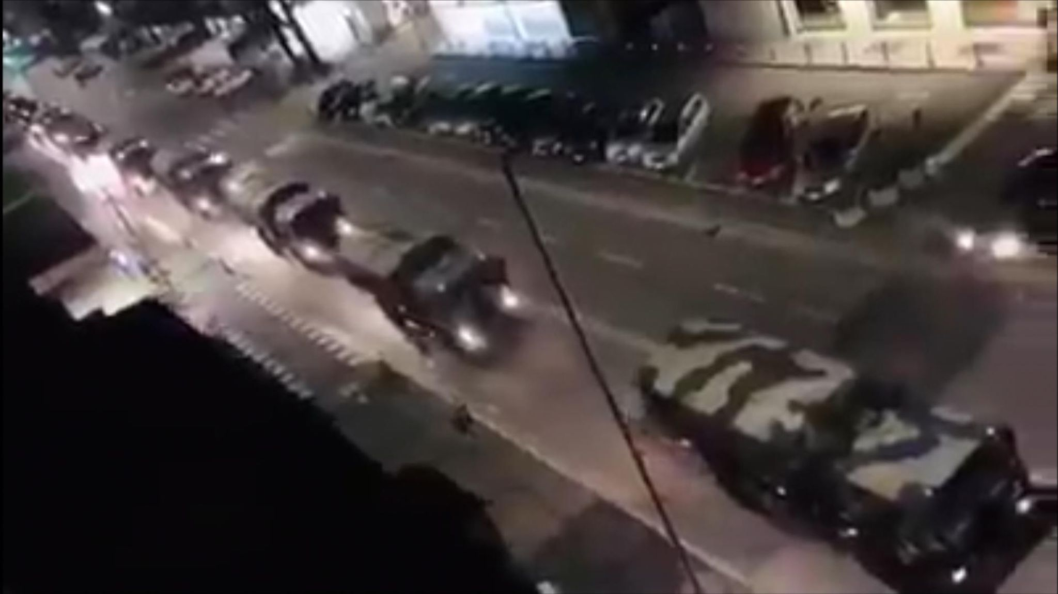
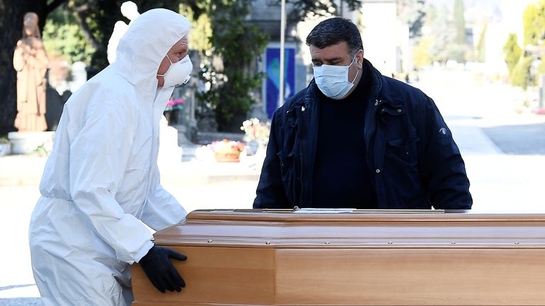
COVID - 19 Italian Army in Bergamo

Slide 3
MY TRAUMA BACK GROUND

Slide 4
MY TRAUMA BACK GROUND
AT THE AGE OF 7yrs My Mother Died in Front of Me

Slide 5
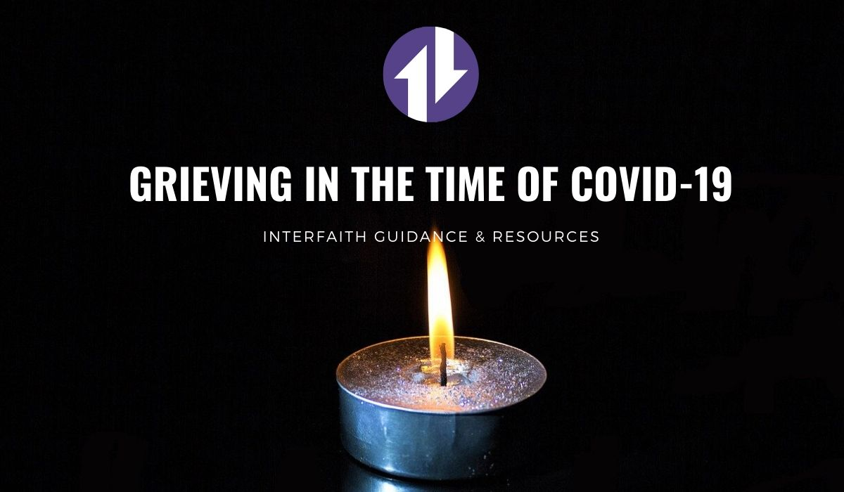

Slide 6
GAINING INSIGHT
INTO OUR
OWN
RESPONSE
TOWARDS GRIEF

Slide 7
DRAW THREE CIRCLES
GRIEF OVERLOAD
EXPERIENCE / EVENT
GRIEF RESPONSE
THINKING
/ FEELINGS
/BEHAVIOUR
?

Slide 8
THREE QUESTIONS:
Think about the last 6 / 12 months
  When was the point / day / week when you were feeling overwhelmed or overloaded due to grief in yr context.
    Describe it
  What did you do as a minister with the grief - loss you have encountered ?
    Write it down
  What was the one question you were asking about the grief you’ve encountered ?
    Write it down

Slide 9
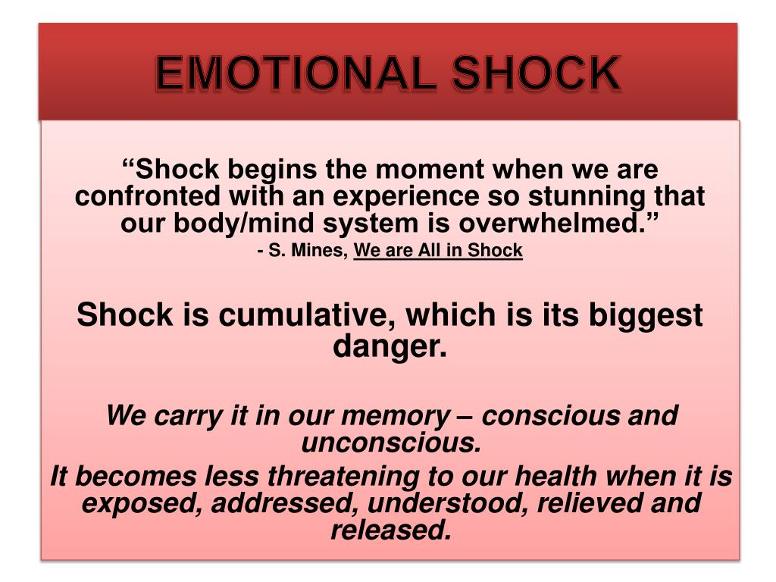

Slide 10
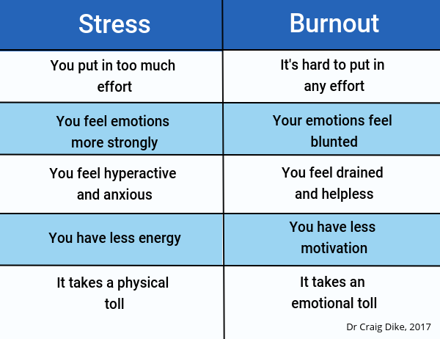

Slide 11
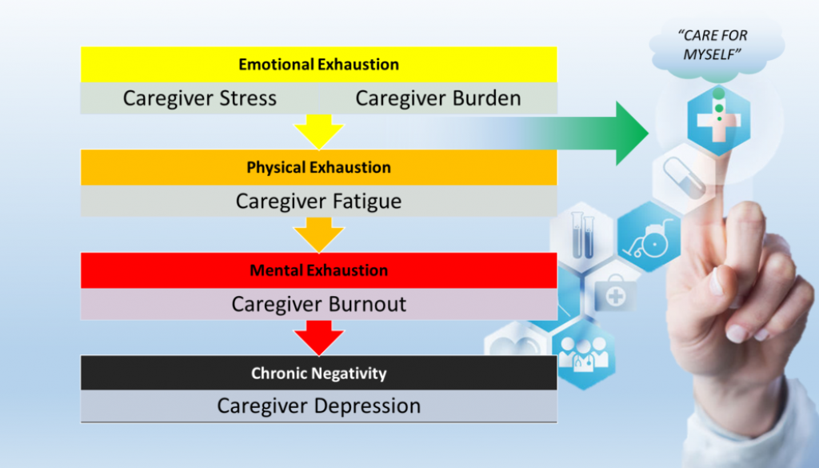

Slide 12
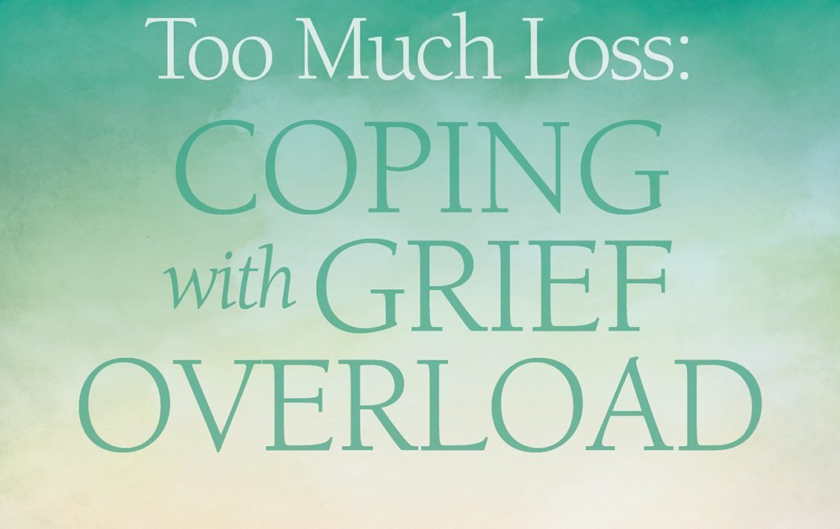

Slide 13
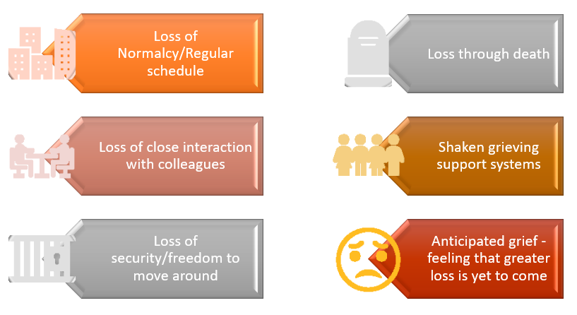
Covid-19 pandemic has triggered all kinds of losses, including:

Slide 14
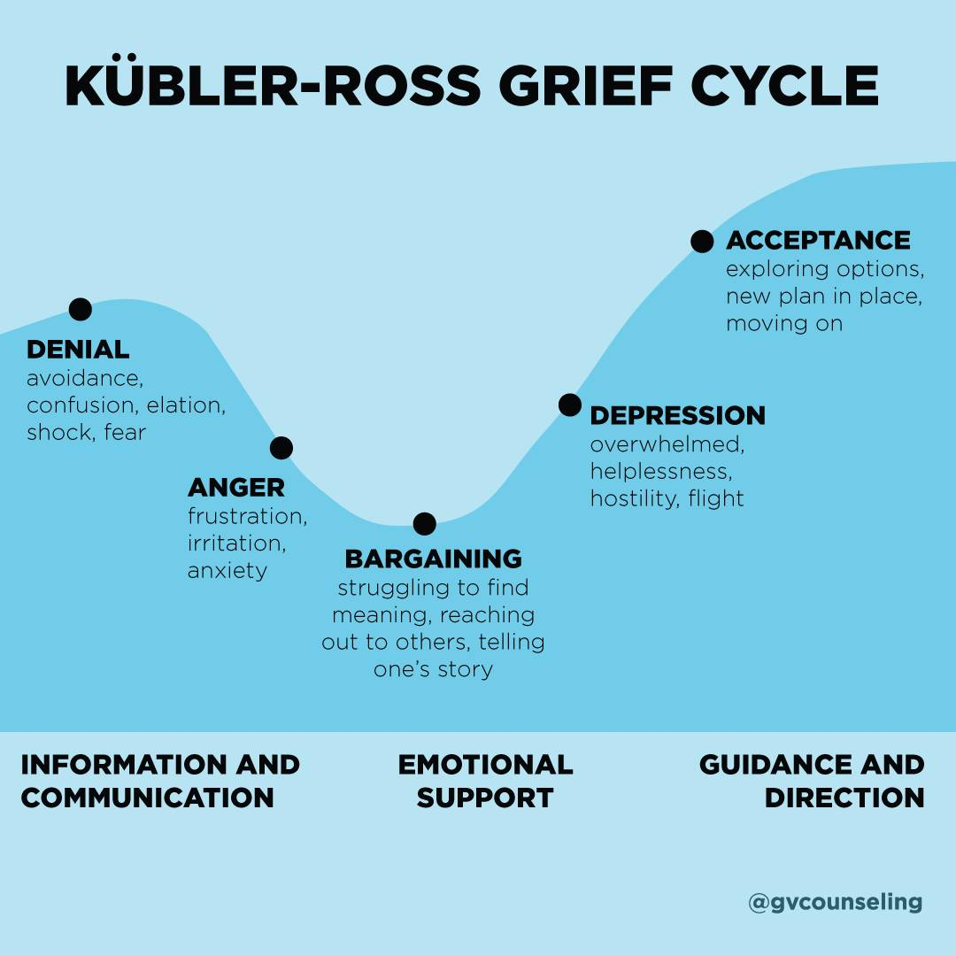

Slide 15
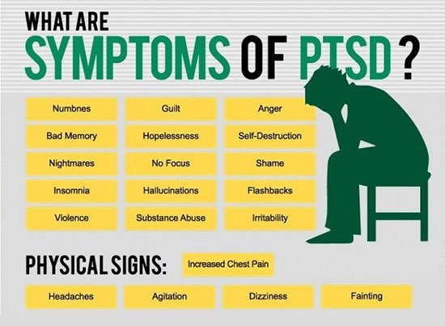

Slide 16
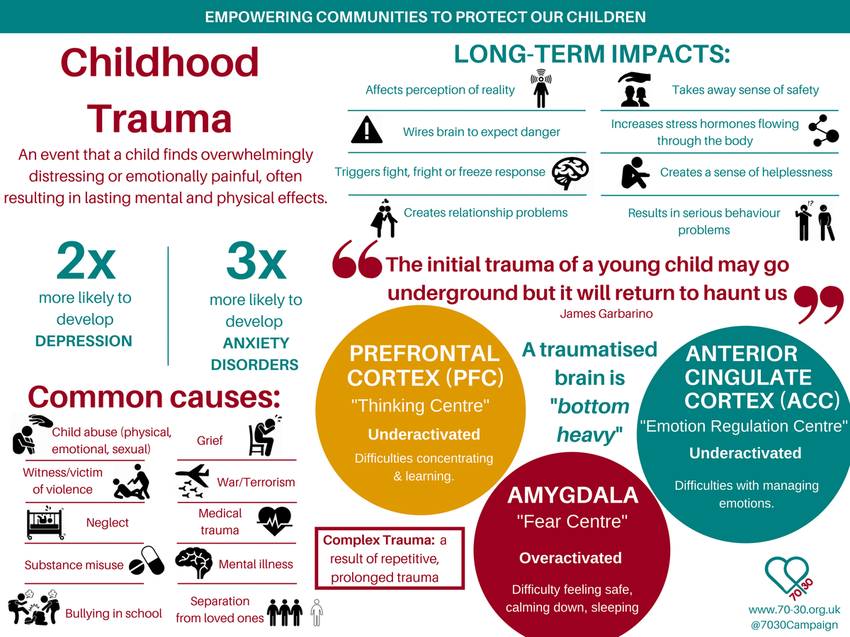

Slide 17


Slide 18
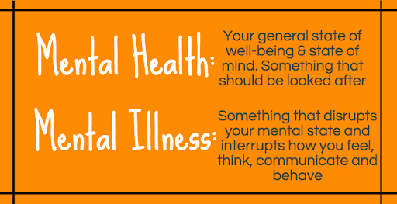

Slide 19
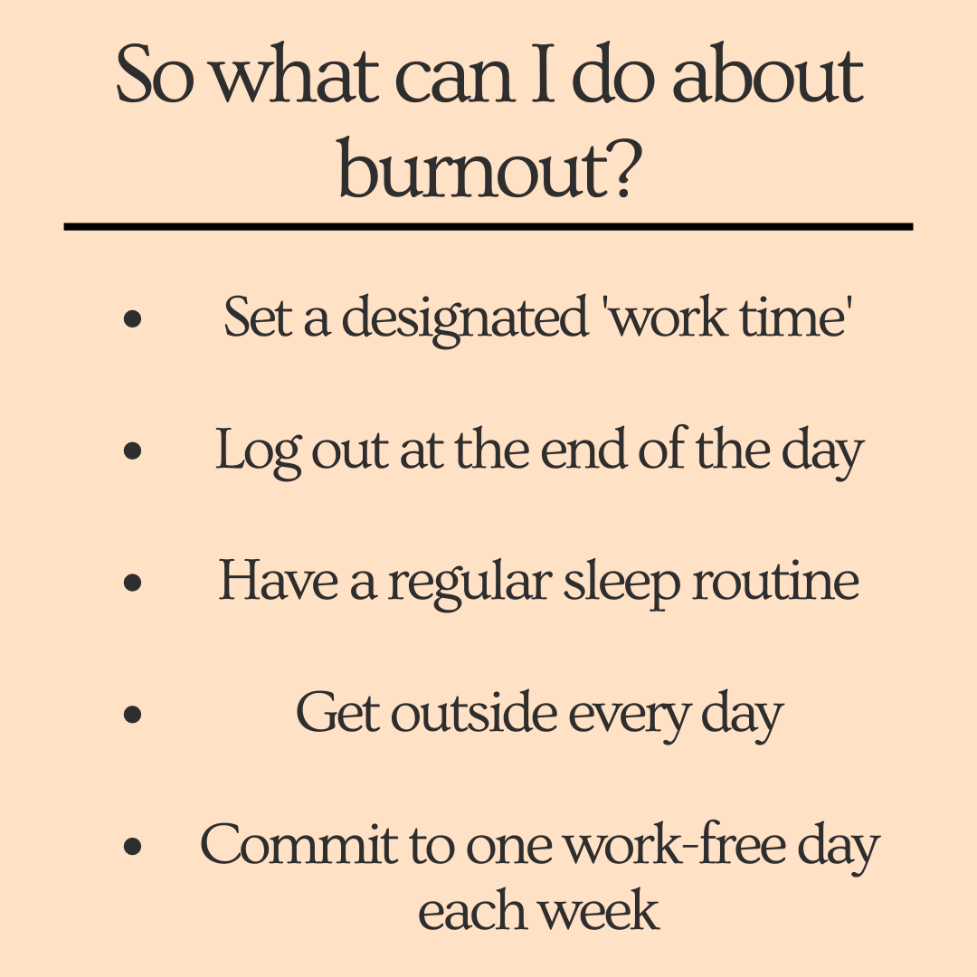

Slide 20
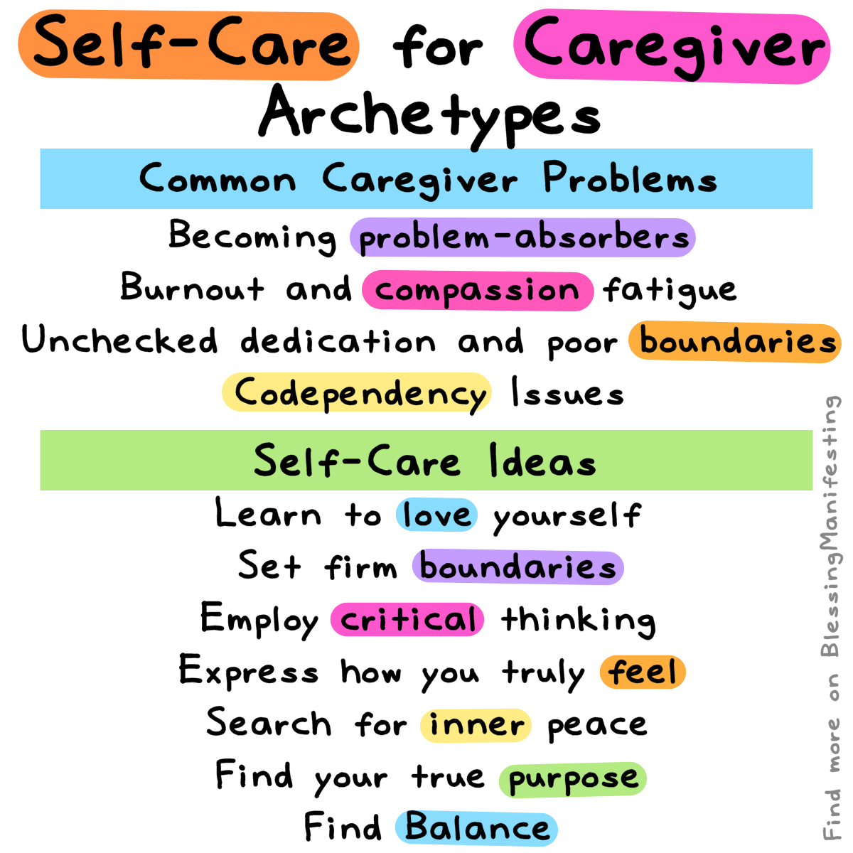

Slide 21
